Slide 1
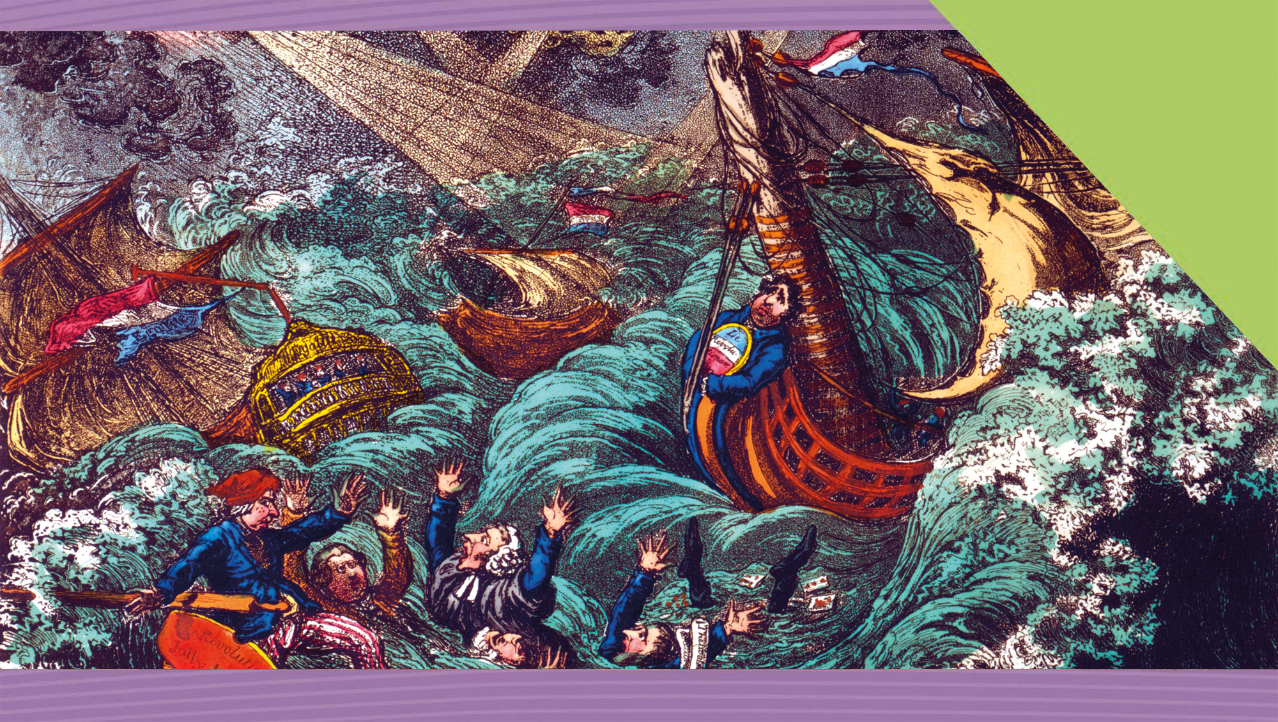
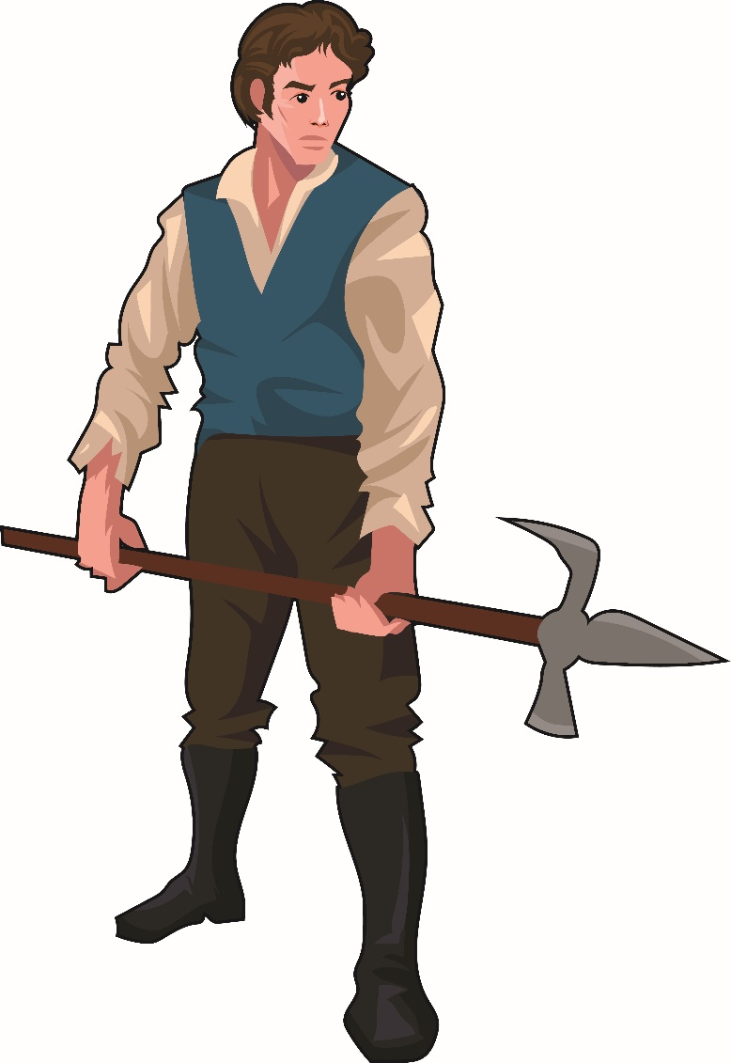

Exploring the 1798 Rebellion The Impact of the Physical Force Tradition on Irish Politics
11
Making History (2nd Edition)

Slide 2

What Will I Learn?
Explore the impact of the physical force tradition on Irish politics
Explore the impact of the 1798 Rebellion
Examine controversial issues
Explore the job of the historian

Slide 3
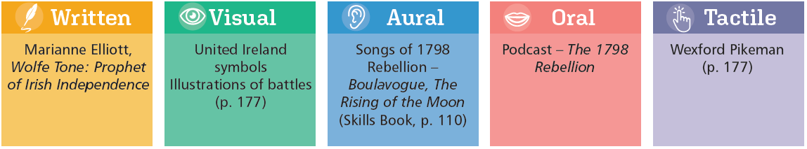
Sources for the 1798 Rebellion

Slide 4
Key Words
Controversial issues | events, people or ideas over which there is serious disagreement
Discrimination | unjust treatment of different people, usually based on race, religion or sex
Fenians | Irish political group formed in mid-19th century that believed in the use of physical force to achieve Irish independence, also known as IRB
Impact | the effect or influence of a movement, event or person
Nationalism | political belief that the world is divided into nations and that each nation should have its own government
Parliamentary tradition | belief in use of peaceful means to achieve political change, and to achieve Irish independence; opposed to physical force tradition
Passive resistance | non-violent or peaceful opposition to government, not co-operating with government, refusal to obey laws; opposed to physical force
Penal Laws | laws passed in 17th and 18th century Ireland to control/discriminate against Catholics and Presbyterians

Slide 5
Key Words
Physical force tradition | belief in use of revolution, armed uprising to achieve Irish independence; opposed to parliamentary tradition
Protestant Ascendancy | the control exercised by Church of Ireland/England members, usually landowners, over Catholics and Presbyterians in Ireland in 18th century and later
Republic | a country or government ruled by a lay person, not a monarch (king or queen)
Republicanism | political belief in Ireland that wanted complete independence from Britain and to establish a republic (a government without a monarch), by physical force (rebellion)
Sectarianism | a form of hatred aimed at opposing (usually) religious groups
Tithe | one-tenth of the annual crops given to support the clergy in the Catholic Church or the Church of Ireland
Unionism | political belief that wanted to maintain the union with Britain, that parliament in Westminster would continue to make laws for Ireland

Slide 6
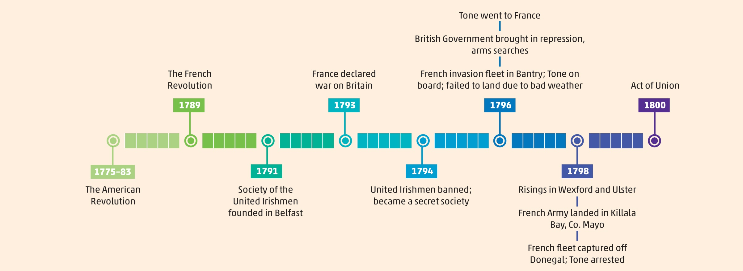
Timeline of the 1798 Rebellion

Slide 7
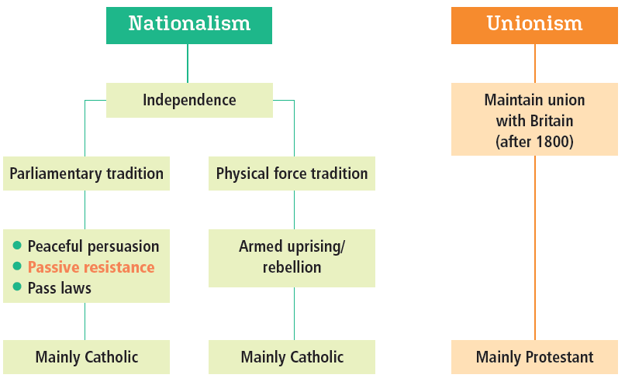
Political Traditions in Modern Ireland

Slide 8
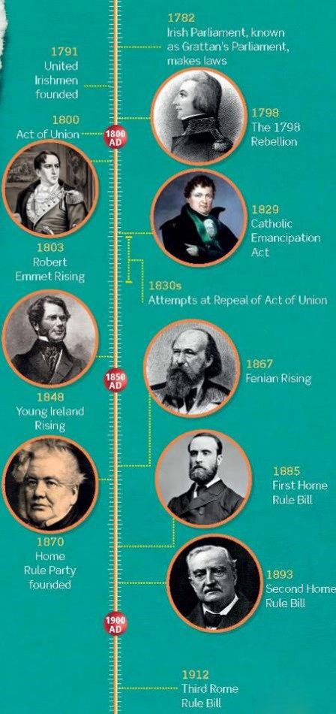
Political Traditions in Modern Ireland – Nationalism
Parliamentary tradition
OR
Physical force tradition
1
 | 1
 | 2
 | 3
 | 4
 | 5
 | 6
 | 7
 | 8
 | 9
3
2
4
6
5
8
7
9

Slide 9

Assessing Your Learning
Name one primary and one secondary written or visual source from the sources for studying the 1798 Rebellion.
Is a podcast a primary or a secondary source? Explain your answer.
What are the two main political traditions in Ireland?
Explain parliamentary tradition.
Explain physical force.
Name one leader of the parliamentary tradition and one leader of the physical force tradition.

Slide 10
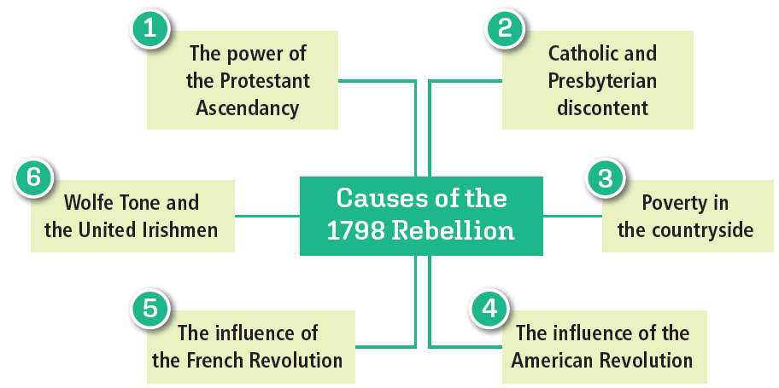
Create your own mind map on the Causes of the 1798 Rebellion using the above features.

Slide 11
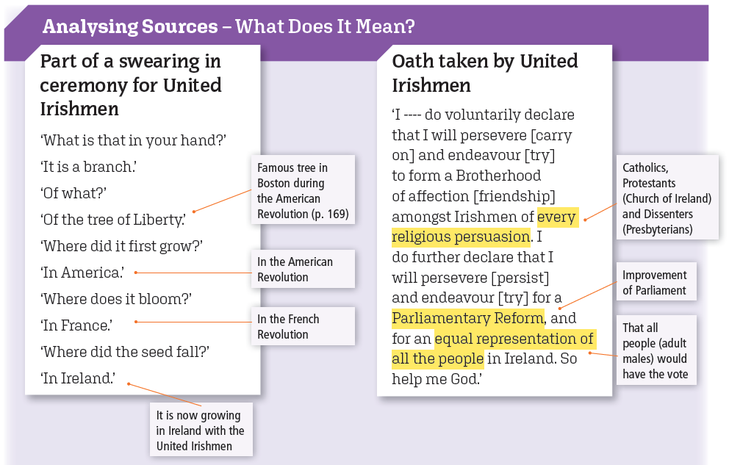

Slide 12
Assessing Your Learning
The Protestant Ascendancy was
(i) the control by the Presbyterian Church
(ii) the political control of Ireland by the members of the Church of Ireland OR
(iii) Catholics who were converted to Protestantism.
Explain the Penal Laws.
Which religious groups in Ireland made up (i) 10% (ii) 15% of the population?
In what part of Ireland did most Presbyterians live?
Who paid tithes and to whom were they paid?
How did subdivision affect poverty in the countryside?
How did (i) the American Revolution and (ii) the French Revolution contribute to the causes of the 1798 Rebellion?
Where was the United Irishmen organisation founded?
Give one of its aims.

Slide 13
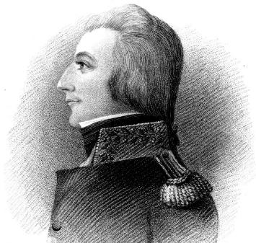
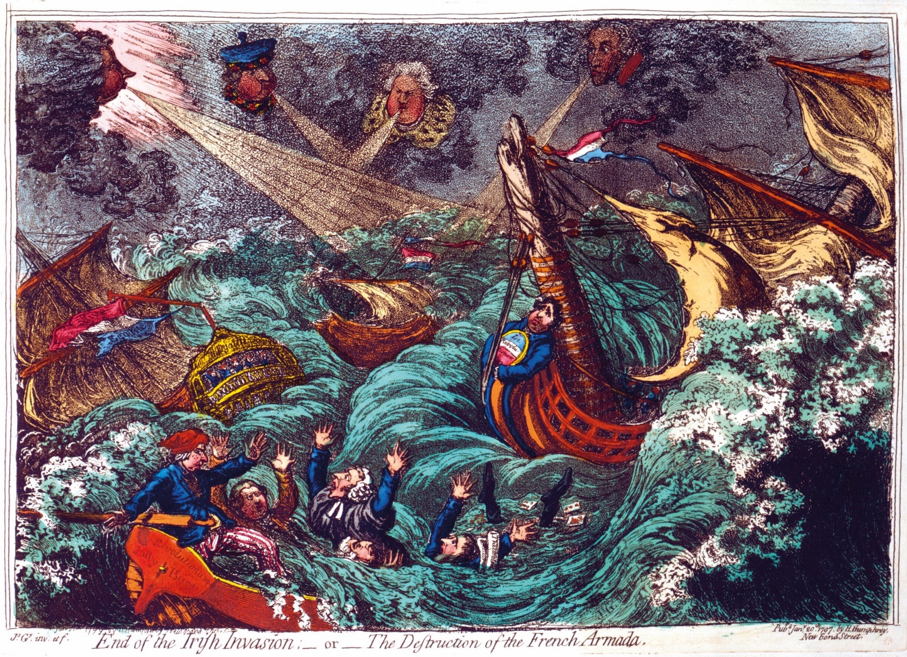
Wolfe Tone
A Dublin lawyer
Present at the founding of the United Irishmen in Belfast
Wrote An Argument on Behalf of the Catholics of Ireland (1791)
Disappointed that the British Government did not get rid of all Penal Laws
War broke out between Britain and France
Tone went to America
Then got help from France
French fleet failed to land at Bantry Bay (1796)
Tone disappointed
End of the Irish Invasion; – or – the Destruction of the French Armada (1797)

Slide 14

How did Tone’s ideas change?
July 14th [1791]. I sent down to Belfast, resolutions suited to this day, and reduced to three heads. 1st. That English influence in Ireland was the great grievance [complaint] of the country. 2nd. That the most efficient way to oppose it was by a reform in Parliament. 3rd. That no reform could be just which did not include the Catholics.
(Tone’s Diary)
To subvert [undermine] the tyranny [oppression] of our very bad Government, to break the connection with England, the never-failing source of all our political evils, and to assert the independence of my country – these were my objects [aims]. To unite the whole people of Ireland, to abolish the memory of all past dissentions [disagreements], and to substitute the common name of Irishman in place of the denominations [religions] of Protestant, Catholic and Dissenter [Presbyterian] – these were my means [methods].
(The Autobiography of Theobald Wolfe Tone [1937])
How do Tone’s ideas differ here?
Why did they change?

Slide 15
Assessing Your Learning
What was the name of Wolfe Tone’s pamphlet about Catholics in Ireland?
Why was Tone disappointed with the British Government?
How did war between Britain and France change everything?
Where did Tone go for help for the rebellion?
What help was provided to Tone?
How did Tone’s ideas change?

Slide 16
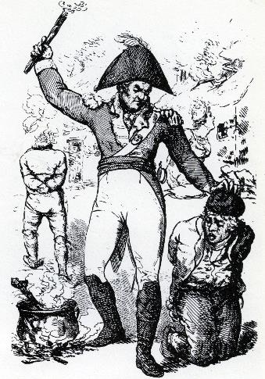
Closer to the Rebellion
British troops burn houses, flog and torture suspects
Arms confiscated in Ulster and Leinster
Conflict between Catholics and Protestants in Ulster
Orange Order founded
United Irishmen leaders, including Lord Edward Fitzgerald, arrested
Pitch-capping

Slide 17
Closer to the Rebellion
Croppies Lie Down!
We soldiers of Erin, so proud of the name,
We’ll raise on the rebels and Frenchmen our fame;
We’ll fight to the last in the honest old cause,
And guard our religion, our freedom and laws;
We’ll fight for our country, our King and his crown,
And make all the traitors and croppies lie down.
Down, down, croppies lie down.
The rebels so bold, when they’ve none to oppose,
To houses and haystacks are terrible foes;
They murder poor parsons and likewise their wives,
At the sight of a soldier they run for their lives;
Whenever we march over country and town
In ditches and cellars the croppies lie down.
Down, down, croppies lie down.
What is the meaning of this song?
What is the purpose of the song?
An anti-rebel song from 1798

Slide 18
Assessing Your Learning
What were the main features/characteristics of the parliamentary tradition?
What were the main features/characteristics of the physical force tradition?
Which of these were causes of the 1798 Rebellion?
Influence of the American Revolution
Discrimination against women
Poverty in the countryside
The power of the Catholic Ascendancy
Where were the United Irishmen founded?
Where did the French fleet with Wolfe Tone on board fail to land in 1796?
Who said, ‘I would be ready, cheerfully, to spill my blood in his [King’s] service’?

Slide 19
Assessing Your Learning
What actions did the British Army carry out which provoked the 1798 Rebellion? OR What actions did the British Government take to try to stop the rising?
What organisation was founded by Protestants in Ulster to combat Catholics?
Where did Catholics and Protestants clash?
How large an organisation was the United Irishmen?
Which leader of the United Irishmen was caught?

Slide 20
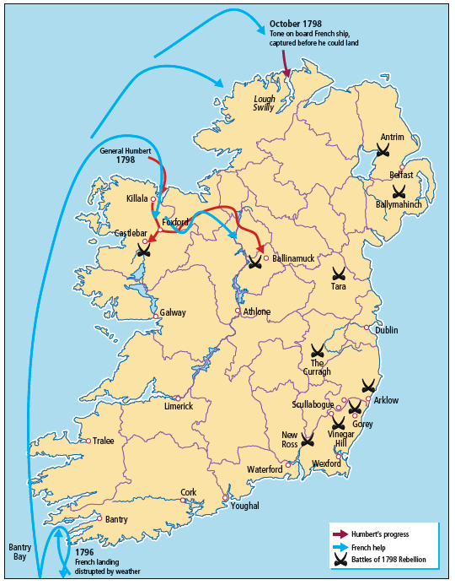
The Rising of 1798
3
4
What were the main events of the 1798 Rebellion?
1
2

Slide 21
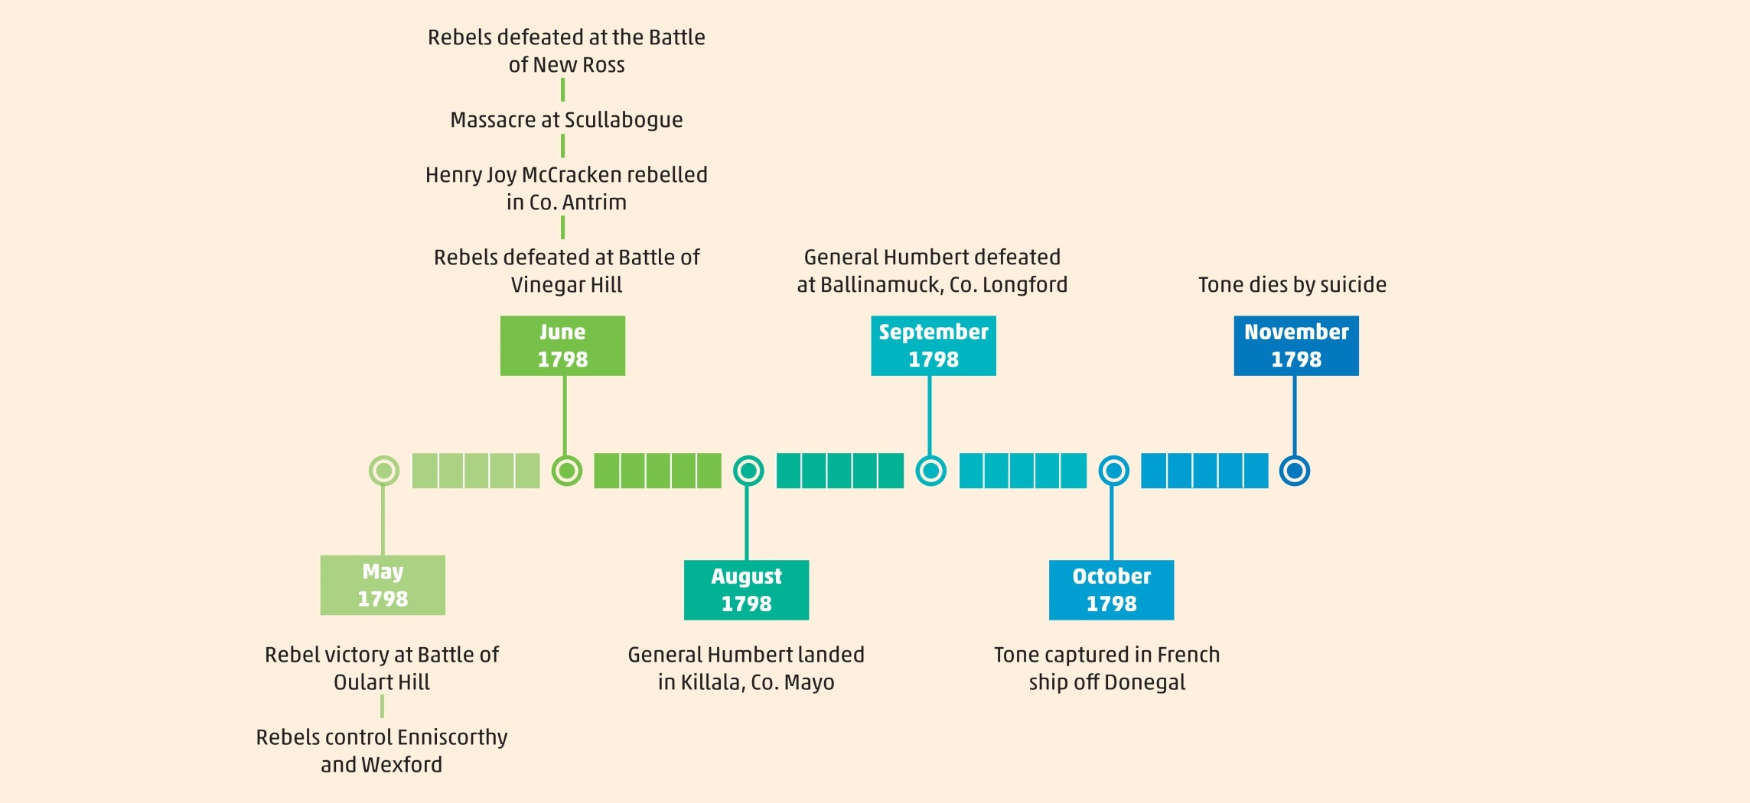
What Happened during the 1798 Rebellion?

Slide 22
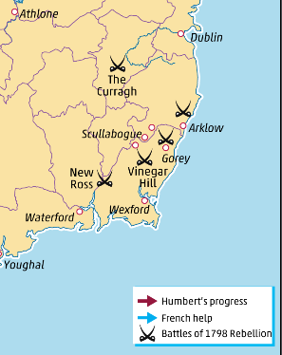
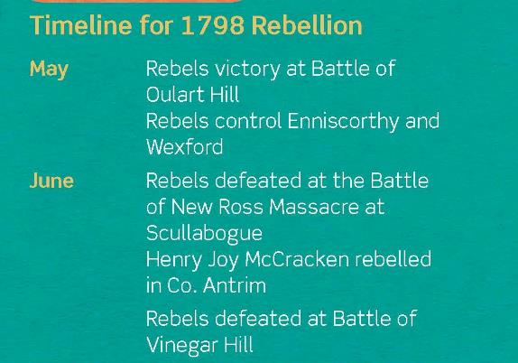
1798 Rebellion – Events in Wexford
What were the main events of the 1798 Rebellion in Wexford?

Slide 23
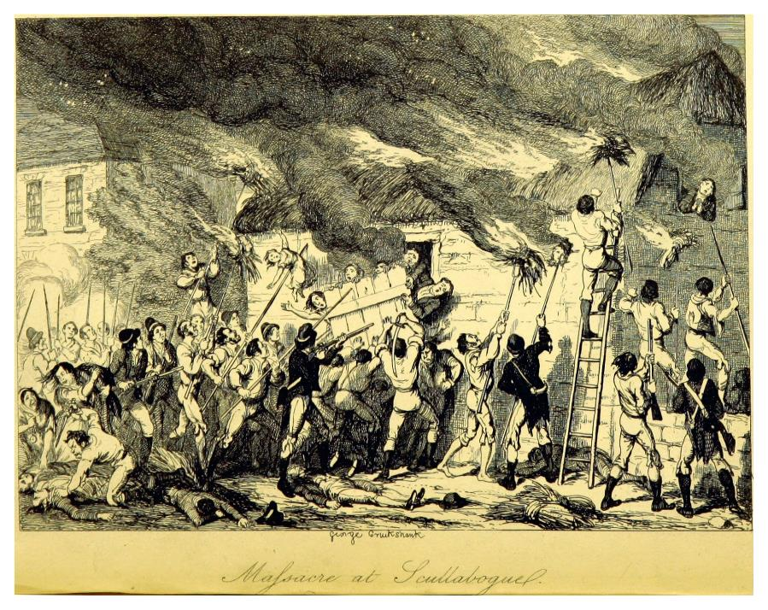
Massacre at Scullabogue
What is happening in this drawing of the Massacre at Scullabogue?
What do you know about this source?
Is this source reliable and useful?

Slide 24
Sources and Evidence about the Scullabogue Massacre
Source A
… The evidence strongly suggests that the killings took place as an immediate reaction to atrocities in the battle of New Ross, raging six miles away. … Finally, while it cannot be denied that sectarian hatred [hatred between religions, groups] had some part to play in the affair, I suspect that as we learn more about the crime and the people who carried it out, … the sectarian dimensions [aspect] will then come to appear far more incidental [less important] to the affair than it has seemed up to this.
(Daniel Gahan, The Scullabogue Massacre 1798, in History Ireland, 1996)
Why did the massacre occur, according to this historian?
How important a part did sectarian hatred play in the massacre, according to this historian?

Slide 25
Sources and Evidence about the Scullabogue Massacre
Source B
The killings were not a matter of mob frenzy … but a military-style operation operation carried out by a small number of men … So far as we know all of [the Catholics] were imprisoned and killed because of their connection with local Protestants … Apart from [the wife and son of a yeoman], none [of the total killed] had any known connection with the military; … Most died mainly because they belonged to recently established and deeply resented local Protestant settlements.
(Tom Dunne, The Killings at Scullabogue, in Rebellions: Memoir, Memory and 1798 [2010])
Why did the massacre occur, according to this historian?
How important a part did sectarian hatred play in the massacre, according to this historian?

Slide 26
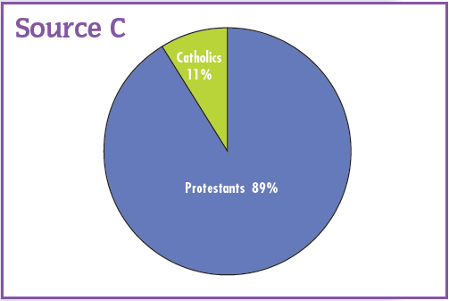
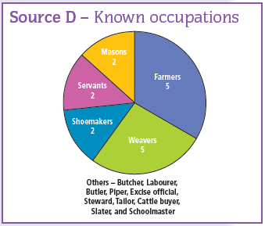
More Sources and Evidence
Does the evidence in Source C and Source D support Source A or Source B? Or neither?

Slide 27
Why were the United Irishmen Defeated?
Leaders
Plans
Reasons for the failure of the Rising of 1798
French help
Rebel forces
Government action

Slide 28
Assessing Your Learning
What signalled the beginning of the rebellion in Dublin, Kildare and Meath?
Name two leaders of the rebellion in Wexford.
Explain ‘yeomanry’ and ‘militia’.
Where were the Wexford rebels eventually defeated?
Who were the leaders of the rebellion in Ulster?
What happened at the Races of Castlebar?
Select two reasons for the defeat of the 1798 Rebellion and explain them.

Slide 29
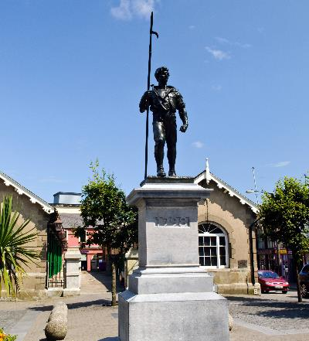
Death and destruction
Act of Union
Impact (Consequences) of the 1798 Rising
Republic and physical force
Catholics and Protestants in conflict
Commemoration
Create your own mind map of the Impact of the Rebellion based on the above features

Slide 30
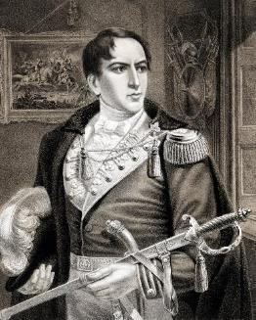
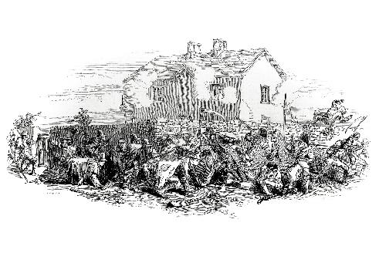
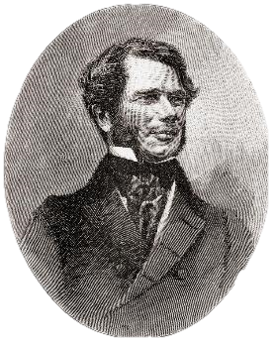
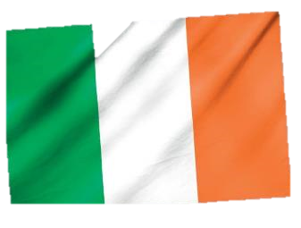
The Physical Force Tradition in the 19th Century
1803
The Rising of 1803
1848
The Young Irelanders Rising of 1848
Robert Emmet
1867
The Fenian Rising of 1867
1916
The 1916 Rising
William Smith O’Brien

Slide 31
Assessing Your Learning
True or false?
A rising was signalled in Dublin, Kildare and Meath with the arrival of the trains.
The yeomanry and the militia fought on the side of the rebels in Wexford.
Father John Murphy and Bagenal Harvey led the Wexford rebellion.
Over 100 Protestants were burned in a barn in Scullabogue.
The rebels were defeated at a major battle on Vinegar Hill.
There was a rising in Ulster in Antrim and Down.
French troops, led by Napoleon, landed in Killala, Co. Mayo.
They defeated the British at the Races of Castlebar.
Wolfe Tone was captured on board a French ship in Bantry Bay.
The Act of Union was passed as a result of the 1798 Rebellion.
The United Irishmen movement favoured a republic as the right form of Irish independence.
As a result of the 1798 Rebellion some thought armed rising was the only way to gain Irish independence.

Slide 32
Assessing Your Learning
How many people were killed in the 1798 rebellion?
Name one town damaged by the fighting.
What was the Act of Union?
Why was it passed?
What lessons had Protestants learned?
What idea did the United Irishmen movement pass on to later generations?
How would that idea be achieved, according to the United Irishmen?
Name one rebellion in the 19th century.

Slide 33

Historical Debate

Slide 34
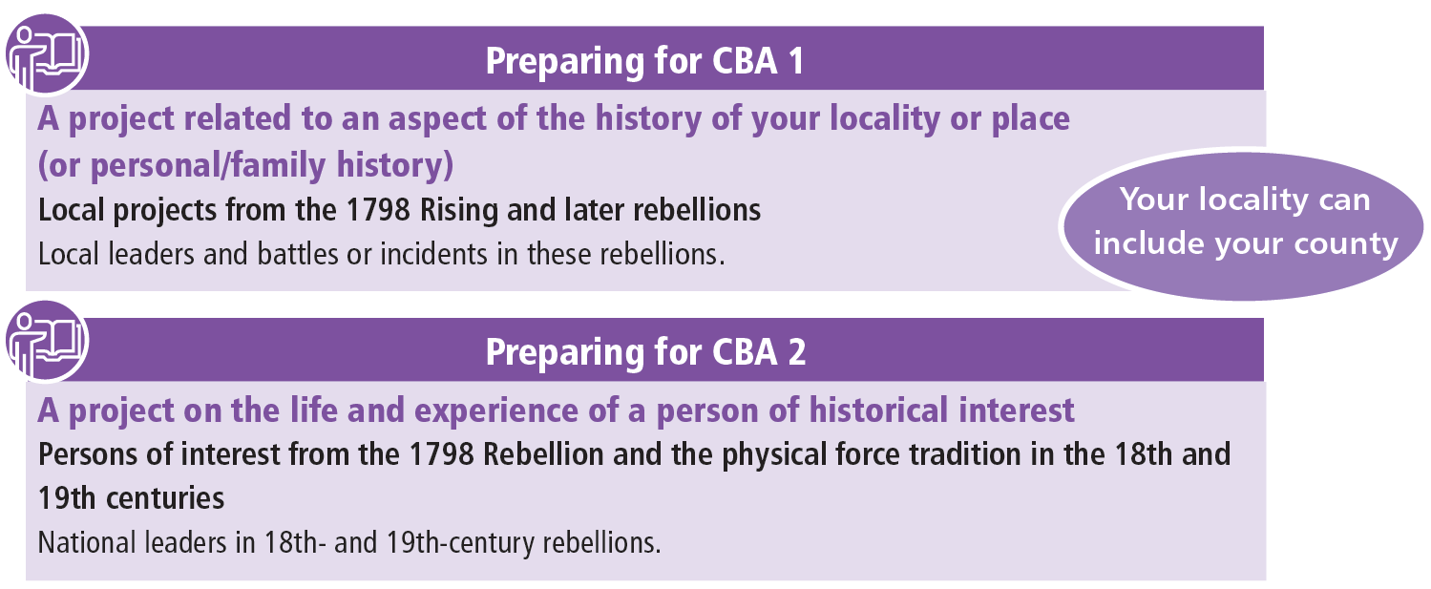
**Note your choices**

